Slide 1
Future Social Service Institute
December 2019

Slide 2
FSSI’s Vision and Mission
WHY WE ARE HERE
Every Victorian will engage with the social service sector during their lives. The existing systems and models are failing us - evidenced by 6 Royal Commissions in 5 years – while we are seeing unprecedented growth in demand.
MISSION
We are here to lead the transformation of the social service industry, by:
* Working with our partners in the community sector, academia, government and philanthropic sector to enable WORKFORCE GROWTH, DIVERSITY AND QUALITY.
* Co-producing leading training, education, information and research to support a highly skilled, paid and unpaid social sector workforce.
VISION
A strong Victoria supported by a responsive and innovative social sector
VALUES
Co-production, Respect, Interdependence, Ethics of Care, Innovation
Learn
Lead
Link
Listen
Notes:
LEAD
We understand the workforce, as it is now and what it needs to be in the future
In a rapidly changing environment, we show what works and why
LISTEN
We foster collaboration with people with lived experience and partners across industry, government and education
LEARN
We pioneer new, partnered approaches to learning, teaching and holistic student support
LINK
We “join the dots” of a vital, diverse & complex sector
We build connections across the silos to enable collaboration and mobility throughout the sector

Slide 3
Challenges facing the Social Service sector are driving innovation
Recruitment and retention
Workforce composition
Training products not “fit-for-purpose”
Need for new skills, knowledge and mindsets
Insufficient evidence and data
Adapting to systemic change
Investment approach
Widening entry gate
New training products and approaches
Responsive curriculum
New pathways and models
Systematic monitoring and data integration

Slide 4


Workforce Data: Breaking Through The Silos
Whole of Workforce Insights
Disability workforce data
Aged care workforce data
Family violence workforce data
Mental health workforce data
Early childhood workforce data
Innovative workforce development initiatives
Microscopic view
Telescopic view

Slide 5

Developing Integrated Data Set: Process Overview
Project scope defined
Identification of workforce data sources undertaken
FSSI definitions developed ("Social Servies" and "Social Services Broad")
"Burning questions" identified by Working Group members
Over 50 data sources identified and evaluated
Working Group input to prioritisation of data sources and FSSI definitions
FSSI definitions confirmed by Working Group
Teams Site set up for Working Group to share data internally
Workforce Intelligence Working Group convened
Data and insights shared with key stakeholders
2020
Workforce Intelligence Framework
Workforce Insights Series
Student projects
Data dashboard built

Slide 6
The Social Service Industry Defined
FSSI’s definition includes selected occupations from Health Care and Social Assistance and Education and Training
Classification | FSSI Social Services | FSSI Social Services Broad
ANZSCO 4 | 4231 Aged and Disabled Carers; 4211 Child Carers; 2721 Counsellors; 4113 Diversional Therapists; 4221 Education Aides; Education, Health and Welfare Services Managers nfd; 1342 Health and Welfare Service Managers; 4115 Indigenous Health Workers; 4233 Nursing Support and Personal Care Workers; 2524 Occupational Therapists; 2534 Psychiatrists ; 2723 Psychologists; Social and Welfare Professionals nfd; 2724 Social Professionals; 2725 Social Workers; 4234 Special Care Workers; 2415 Special Education Teachers; 4117 Welfare Support Workers; 2726 Welfare, Recreation and Community Arts Workers | 1341 Child Care Centre Managers; 2411 Early Childhood (Pre-primary School) Teachers; 2491 Education Advisers and Reviewers; 4114 Enrolled and Mothercraft Nurses; Health Diagnostic and Promotion Professionals, nfd; Health Therapy Professionals, nfd; Midwifery and Nursing Professionals, nfd; 2722 Ministers of Religion; 2542 Nurse Educators and Researchers; 2543 Nurse Managers; 4518 Other Personal Service Workers; 2525 Physiotherapists; 2526 Podiatrists; 4421 Prison Officers; 2544 Registered Nurses; 2527 Speech Professionals and Audiologists
ANZSIC 3 | 871 Child Care Services; 879 Other Social Assistance Services; 860 Residential Care Services | 853 Allied Health Services; 822 Education Support Services; 840 Hospitals; 859 Other Health Care Services; 801 Preschool Education

Slide 7
Core Data Sets
Census 2016, Australian Bureau of Statistics
Employment Projections 2018-2023, Department of Employment, Skills, Small and Family Business 2019
Internet Vacancy Index, Department of Employment, Skills, Small and Family Business Employment Projection Data, 2019
WorkSafe, WorkHealth checks by age and gender and mental injury claims data, 2017

Slide 8
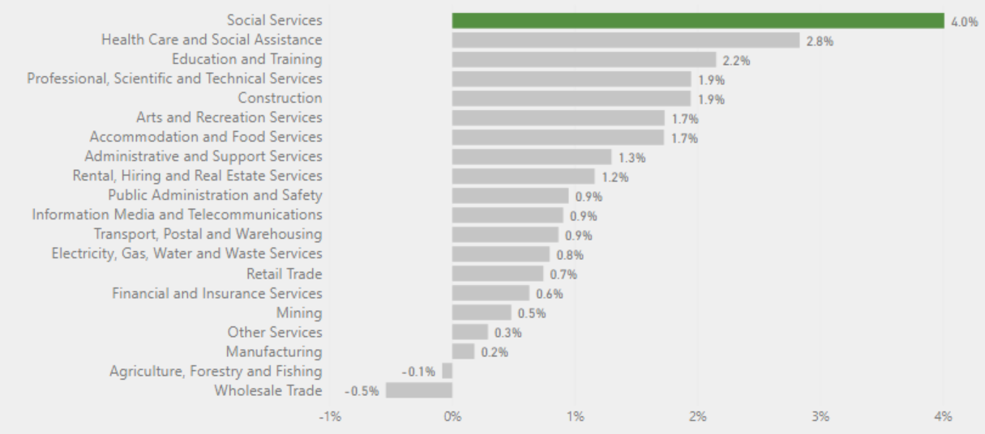
Preliminary Insights: Unparalleled Growth
Social services is the fastest growing workforce in Australia, with 4% projected compound annual growth rate 2018-2023¹. An additional 172,000 social services workers will be required by 2023, 45,000 of these in Victoria¹.
Source: LMIP Employment Projections, 2018
Notes:
The level of projected growth is even higher for FSSI defined Social Services than for Health Care and Social Assistance
The employment level for the social services broadly conceived is projected to grow by nearly 65,000 in the next few years jumping from 369k in 2018 to 434k in 2023

Slide 9
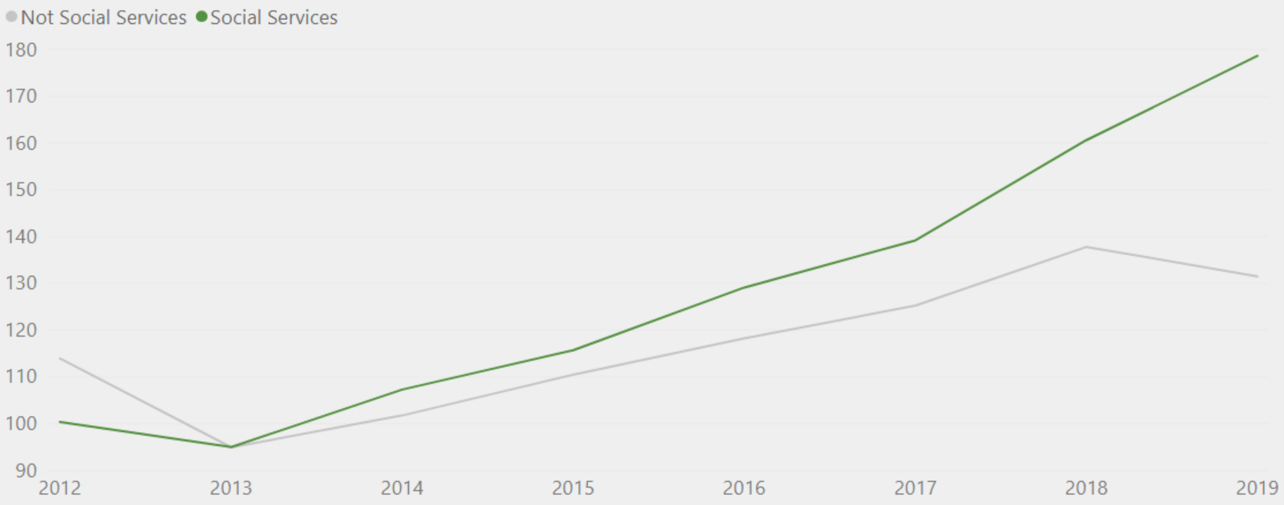
Preliminary Insights: Workforce Shortages
The average monthly internet job vacancies for social service occupations has increased 88% since 2013.
Average monthly internet vacancies per occupation in Victoria
9
Source: LMIP Internet Vacancy Index

Slide 10
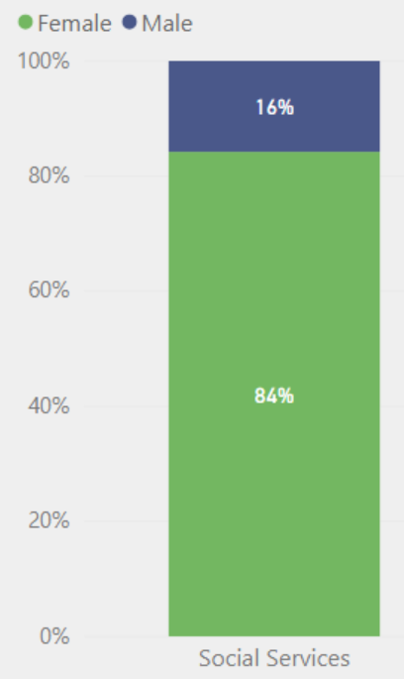
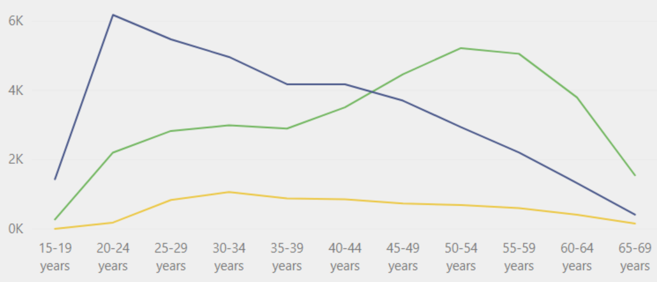
Social Services Demographic Snapshot
More than 4 out of 5 social services workers are female. The workforce are older than the Victorian average, with high levels of variation by occupation.
Gender
Age
Source: Census 2016

Slide 11
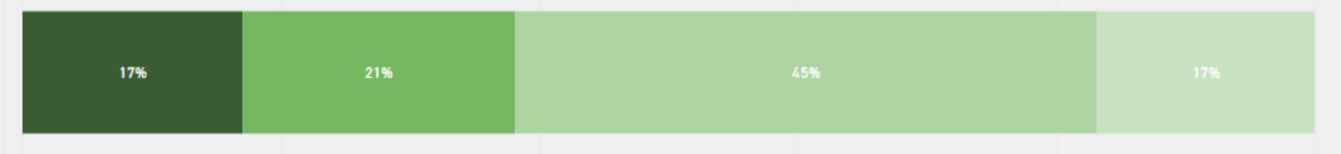
Social Services Workforce Snapshot
The social services workforce are well educated, low paid and work fewer hours than non-social services occupations. Around one in four of WorkSafe Victoria’s mental injury claims come from the wider health care and social assistance industry.
Highest level of educational attainment
Hours
Mental health
60 per cent of the social service workforce work less than 34 hours per week. The figure is 35 per cent for non-social service occupations.
25 per cent of WorkSafe mental injury standardised claims between 2014 and 2017 came from the health care and social assistance industry
Salary
Only 18 per cent of the social services workforce earn above $65,000 per year. The figure is 36 per cent for non-social service occupations.
Sources:
Census 2016
WorkSafe, Mental Injury Claims 2014-2017, 12/17

Slide 12
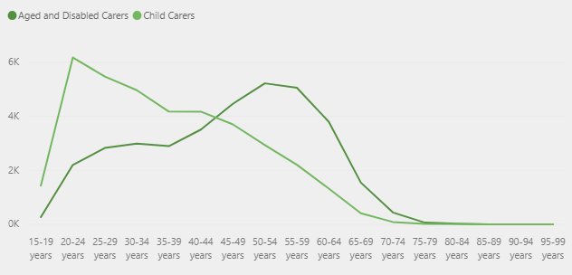
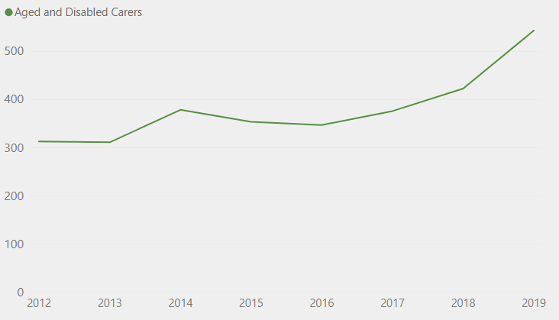
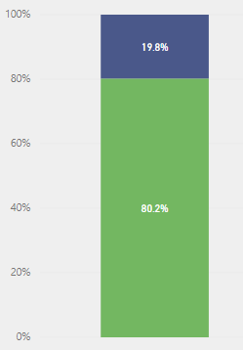
Occupation Insights: Aged and Disabled Carers Snapshot
Projected to be the fastest growing occupation in Victoria 2018-2023 - 7.1% projected compound annual growth rate¹
Average monthly internet job vacancies²
Gender³
Age³
Highest level of educational attainment³
Sources:
¹ LMIP Employment Projections, 2018
² LMIP Internet Vacancy Index
³ Census 2016

Slide 13
Burning questions about the social service workforce
Data at the ANZSCO 4 (preferred) or ANZSIC 3 level allow us to apply FSSI’s custom social services mapping.
Domain | Questions
Workforce Growth | What is the projected growth of the workforce? Where are the highest rates of growth – by occupation and area (e.g. specific LGAs)? What are the job vacancy rates? Numbers of jobs advertised Where are the biggest gaps between supply and demand for services and supports?
Workforce Composition | How diverse is the workforce (e.g. gender, race, ethnicity, language group, age etc)? Does the diversity of the workforce reflect the diversity within the communities it serves? Which groups are underrepresented in the workforce (e.g. Aboriginal and Torres Strait Islanders, CALD)? To what extent do workers move between different parts of the sector (e.g. disability to aged care)? What proportion of the workforce is part of the “black economy” – quantity, value and trends of listings on sites like Gumtree and Craig’s List?
Employment Arrangements | Breakdown by employment type – full-time, part-time, casual Are workers able to work their preferred hours? Breakdown by employment level – entry-level, intermediate, management, senior management etc How long do workers typically stay at the same employment level? Are there particular roles that are not offered at specific employment levels (e.g. part-time managerial roles)? What are the pay rates by employment level and how do they compare with pay rates in other industries?
Training and Qualifications | What level of qualifications do workers possess? When does upskilling or retraining occur, at what point in career and at what level? What are the barriers to training and ongoing professional development? What are the skills gaps in the workforce? Digital literacy and digital inclusion rates among the workforce
Interested in data that can be filtered by geographic area, occupation, demographic characteristics (e.g. gender).

Slide 14
Burning questions about the social service workforce
Data at the ANZSCO 4 (preferred) or ANZSIC 3 level allow us to apply FSSI’s custom social services mapping.
Domain | Questions
Health and Wellbeing | How healthy is the workforce, compared to other workforces? How prevalent is the incidence of work-related stress in the workforce? To what extent does the workforce experience occupational harm and violence? Proximity to work / travel time to work
Financial Wellbeing | How do the superannuation balances of this workforce compare with the workforce of other industries? At what age do workers retire? Housing status of the workforce (e.g. renting, own etc) including risk of homelessness
Recruitment and Retention | What are employers looking for when they are hiring workers (qualifications, experience, values, mindset)? What are the turn-over rates for workers? Why do workers leave employment or change jobs? What are the roles that are “hard to fill” and why (e.g. location)? Are workers willing/able to move for employment and/or education? Do workplaces offer any incentives to encourage people to move for employment?
Lived Experience and Activities Outside of Work | How many workers are also accessing social services? How many workers identify as having lived experience of the system that they are working in? Do workers undertake any unpaid or volunteering roles?
Interested in data that can be filtered by geographic area, occupation, demographic characteristics (e.g. gender)

